Slide 1
RESUME CLASSIFICATION
Project Members:
1.) Mr. Moin dalvi
2.) Mr. Zoheb Kazi
3.) Mr. Soudal Hoda
5.) Mr. Anand Jagdale
6.) Mr. swapnil wadkar
7.) Mr. Nagendra p
4.)Snehal Lawande

Slide 2
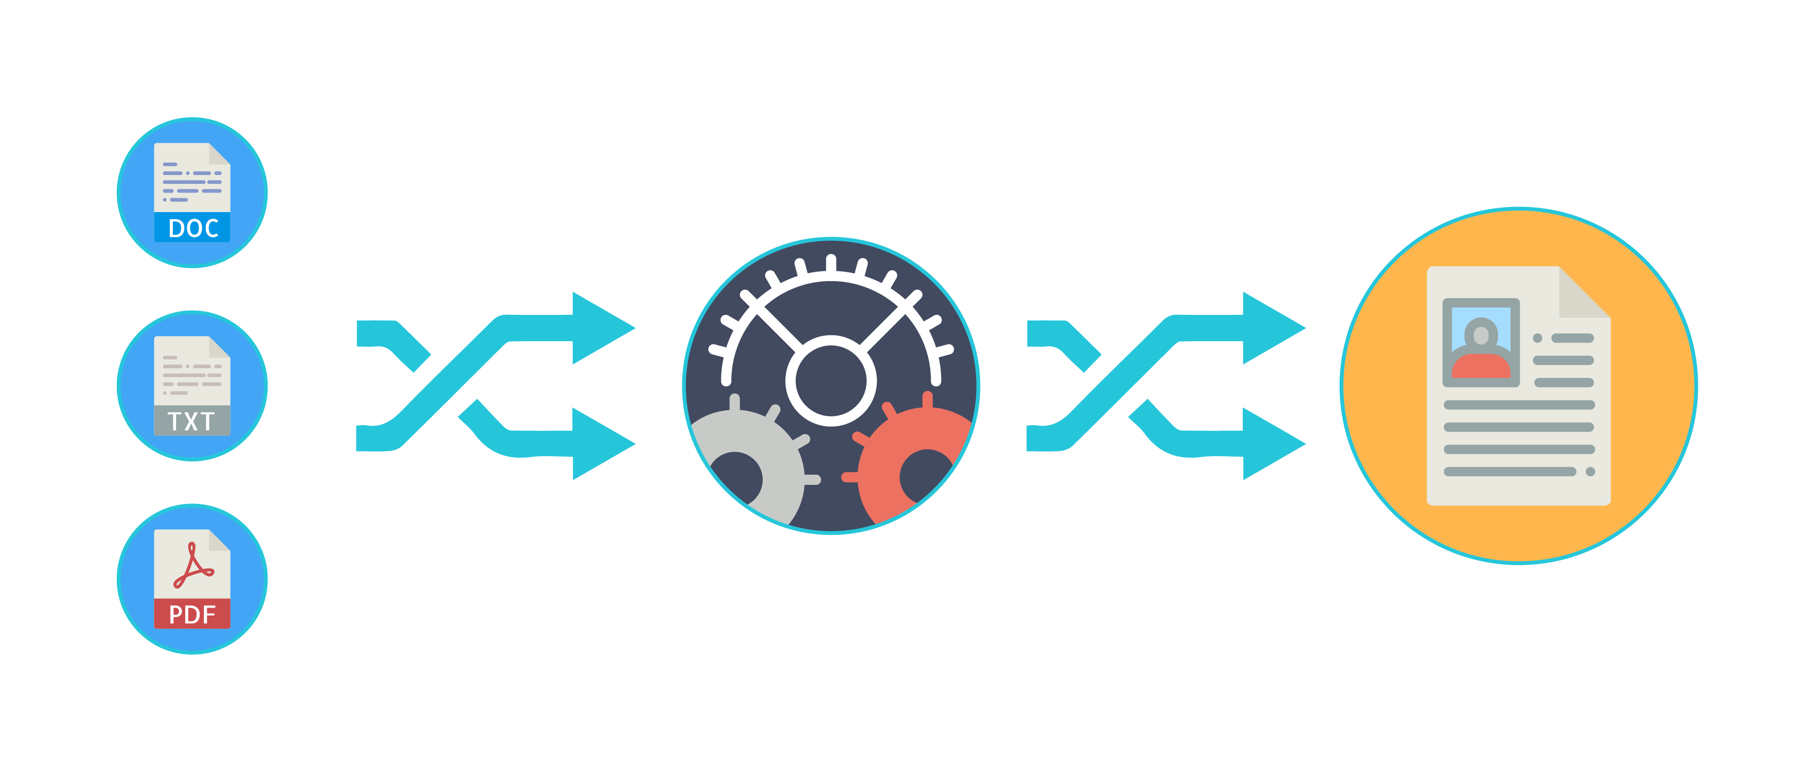
Business objective-
The document classification solution should significantly reduce the manual human effort in the HRM. It should achieve a higher level of accuracy and automation with minimal human intervention
Abstract:
A resume is a brief summary of your skills and experience. Companies recruiters and HR teams have a tough time scanning thousands of qualified resumes. Spending too many labor hours segregating candidates resume's manually is a waste of a company's time, money, and productivity. Recruiters, therefore, use resume classification in order to streamline the resume and applicant screening process. NLP technology allows recruiters to electronically gather, store, and organize large quantities of resumes. Once acquired, the resume data can be easily searched through and analyzed.
Resumes are an ideal example of unstructured data. Since there is no widely accepted resume layout, each resume may have its own style of formatting, different text blocks and different category titles. Building a resume classification and gathering text from it is no easy task as there are so many kinds of layouts of resumes that you could imagine

Slide 3
Introduction:
In this project we dive into building a Machine learning model for Resume Classification using Python and basic Natural language processing techniques. We would be using Python's libraries to implement various NLP (natural language processing) techniques like tokenization, lemmatization, parts of speech tagging, etc.
A resume classification technology needs to be implemented in order to make it easy for the companies to process the huge number of resumes that are received by the organizations. This technology converts an unstructured form of resume data into a structured data format. The resumes received are in the form of documents from which the data needs to be extracted first such that the text can be classified or predicted based on the requirements. A resume classification analyzes resume data and extracts the information into the machine readable output. It helps automatically store, organize, and analyze the resume data to find out the candidate for the particular job position and requirements. This thus helps the organizations eliminate the error-prone and time-consuming process of going through thousands of resumes manually and aids in improving the recruiters’ efficiency.
The basic data analysis process is performed such as data collection, data cleaning, exploratory data analysis, data visualization, and model building. The dataset consists of two columns, namely, Role Applied and Resume, where ‘role applied’ column is the domain field of the industry and ‘resume’ column consists of the text extracted from the resume document for each domain and industry.
The aim of this project is achieved by performing the various data analytical methods and using the Machine Learning models and Natural Language Processing which will help in classifying the categories of the resume and building the Resume Classification Model.

Slide 4
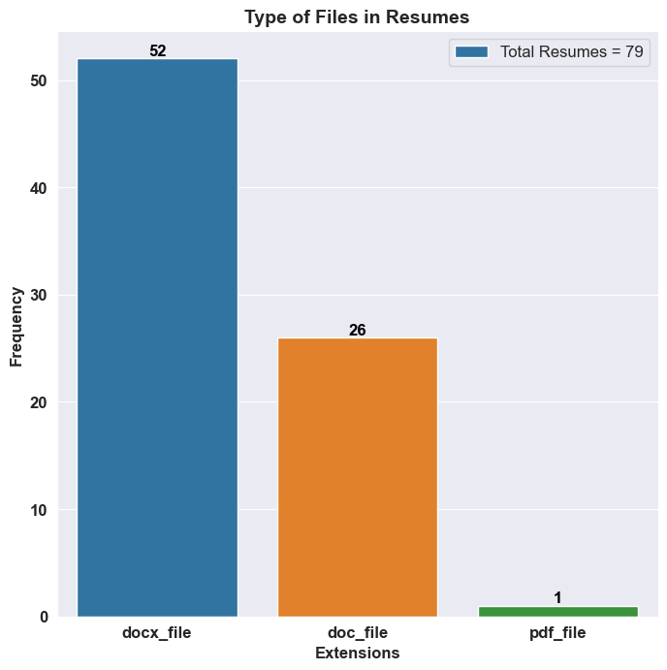
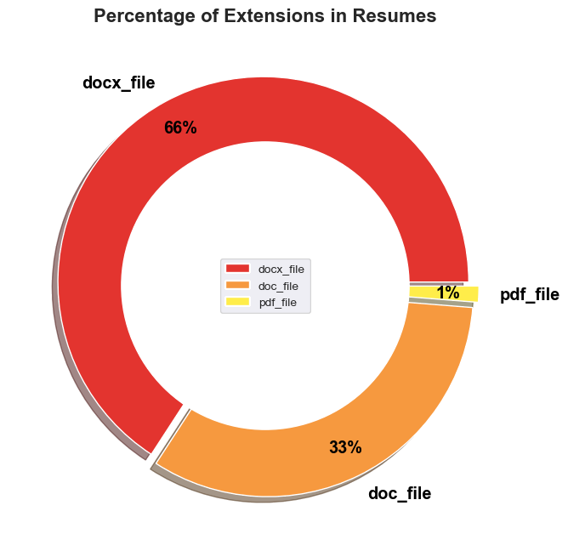
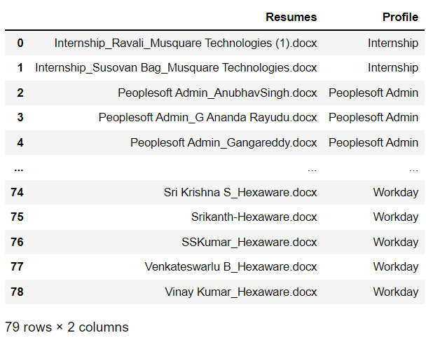
Exploratory Data Analysis :

Slide 5
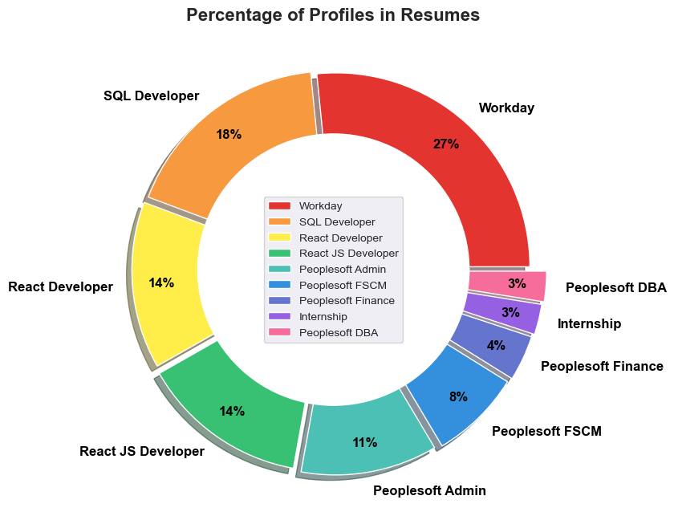
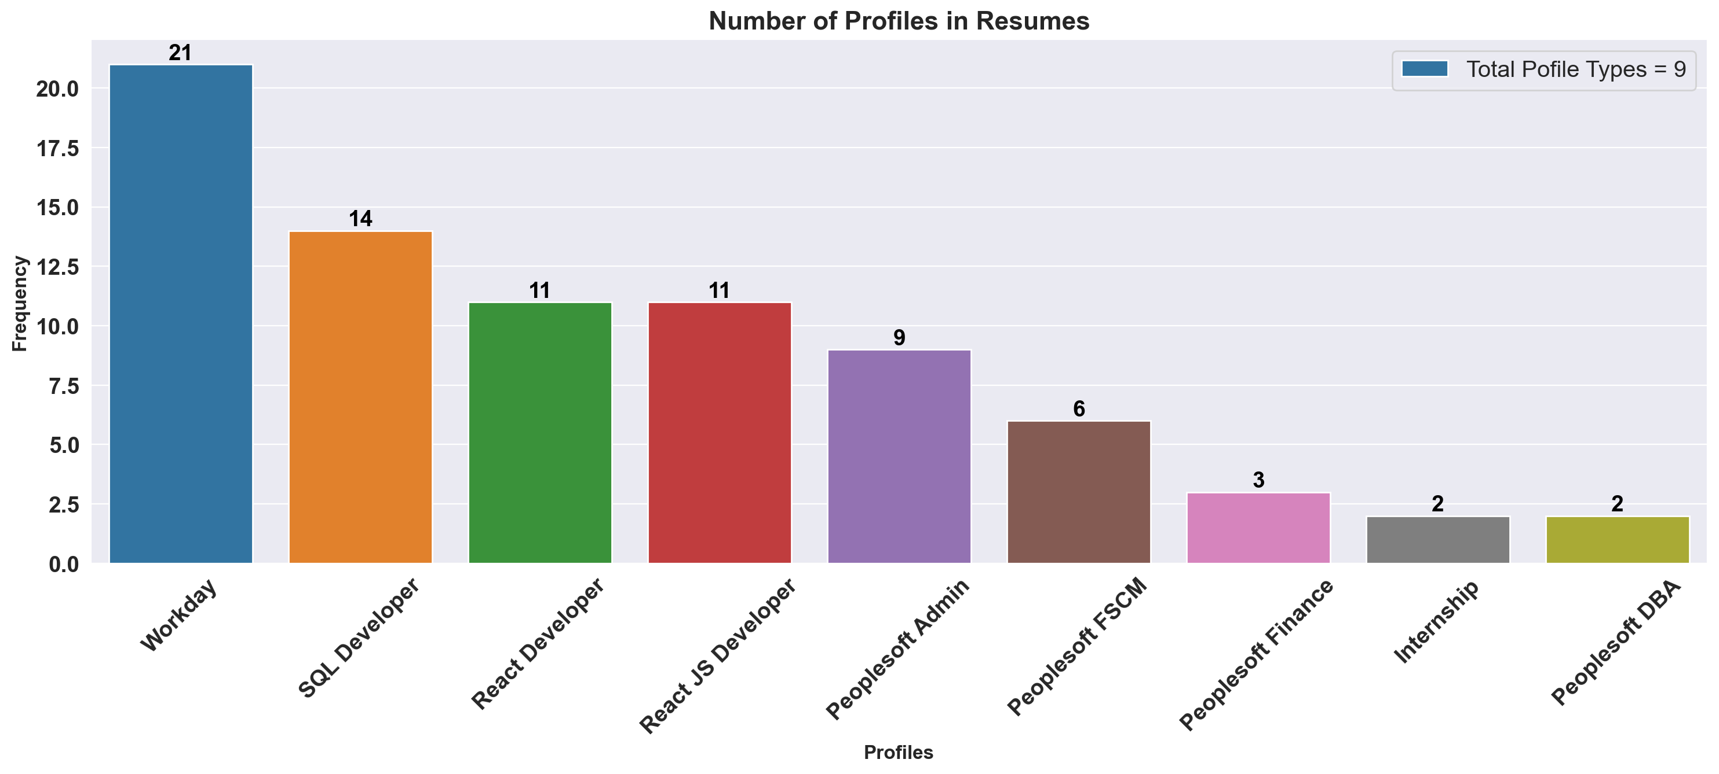
Exploratory Data Analysis :
In this project we have total 9 types of Profiles in the Resumes, and the most of them are for Workday Profile.

Slide 6
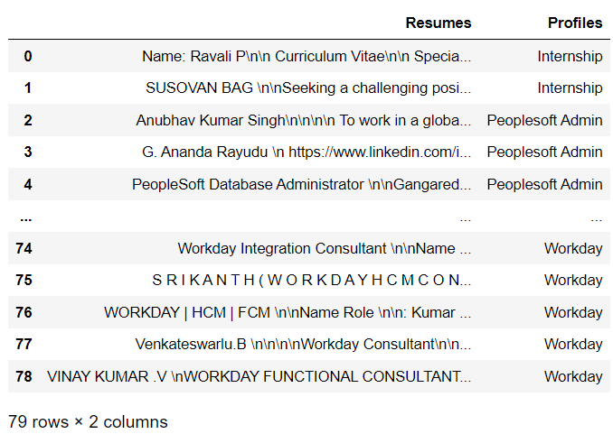
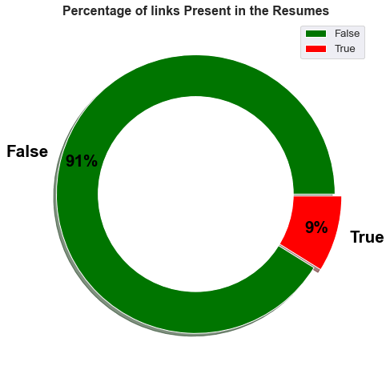
Exploratory Data Analysis :
Extracting Text from different Resume files and creating a data-frame with Column of Text from Resumes And Profile for which each of it Applied for.

Slide 7
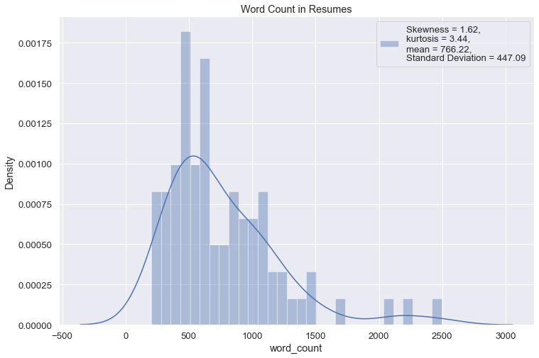
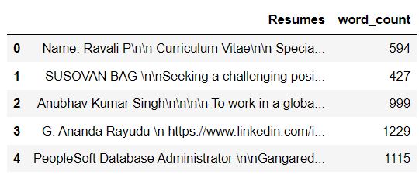
Feature Engineering :

Slide 8
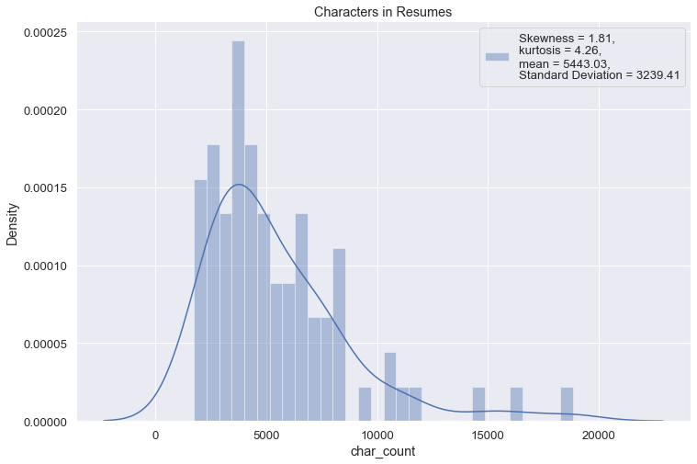
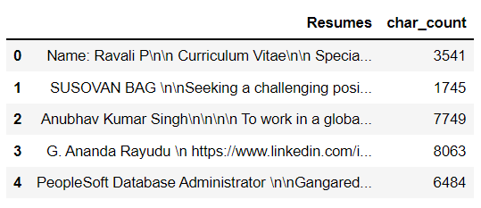
Feature Engineering :

Slide 9
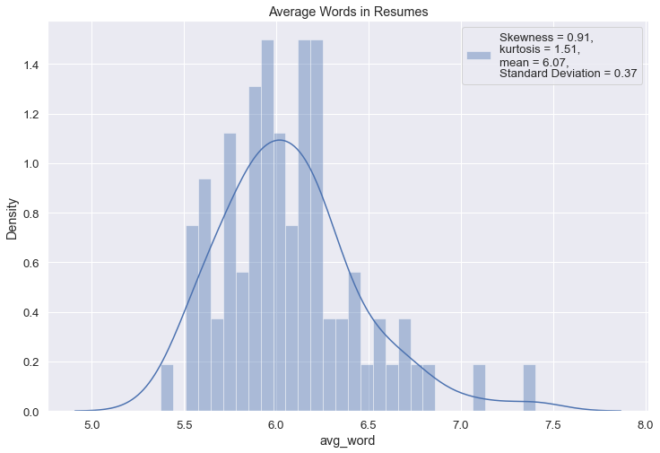
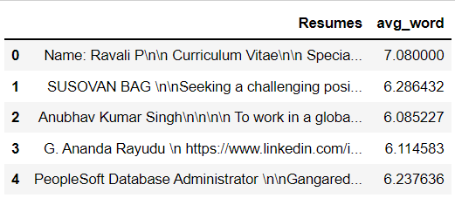
Feature Engineering :

Slide 10
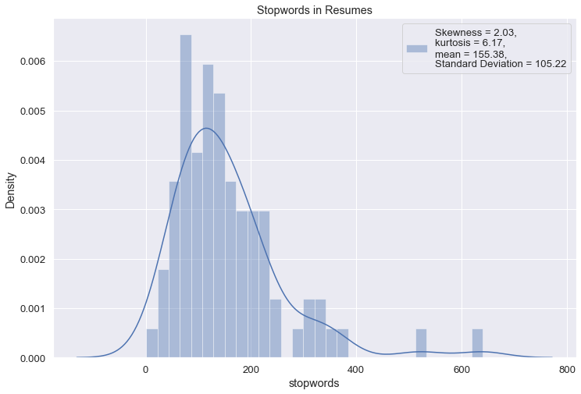
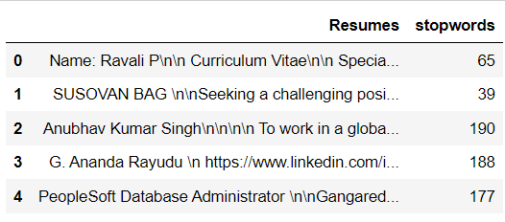
Feature Engineering :

Slide 11
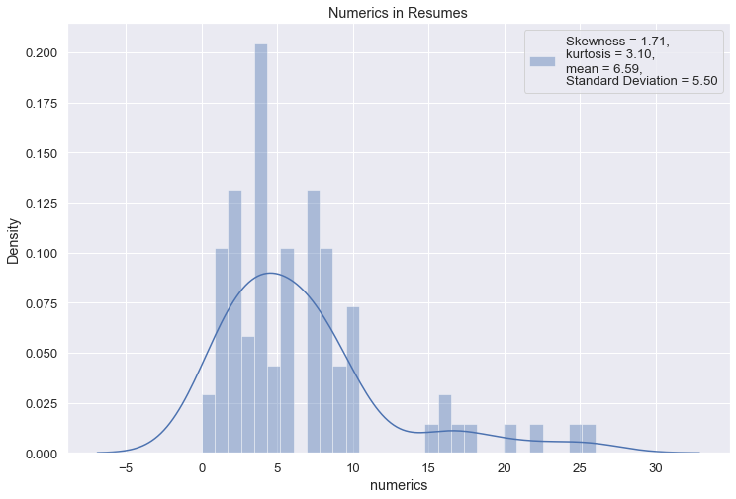
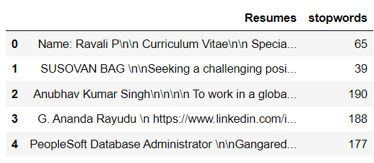
Feature Engineering :

Slide 12
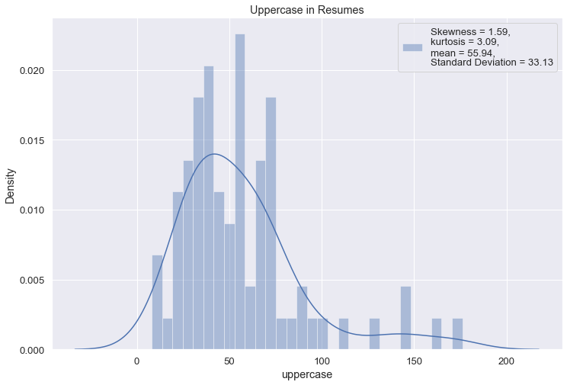
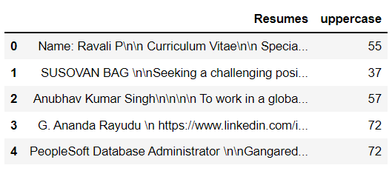
Feature Engineering :

Slide 13
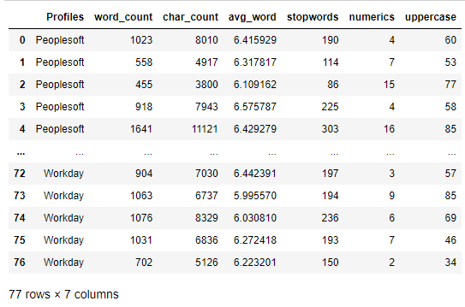
Feature Engineering :
Converting Extracted Above Data into a Data-Frame
To use this as Features (Predictors, Attributes or Input) for Model to Predict the different Classes

Slide 14
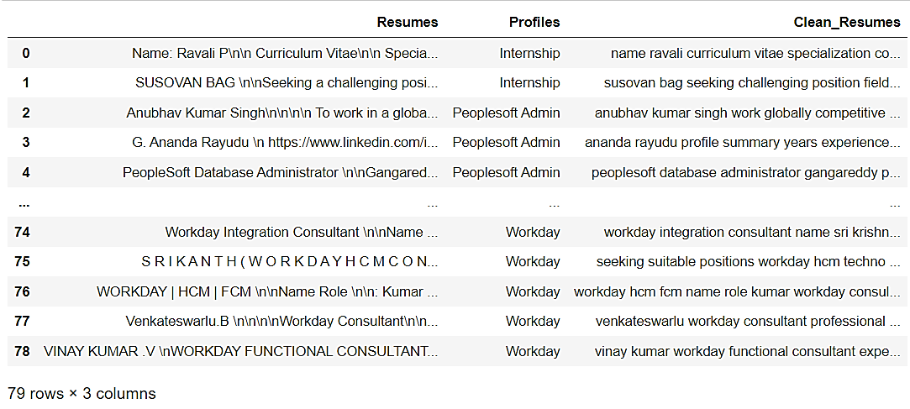
Text pre-processing :
Text pre-processing includes converting to lowercase, removing spaces, html links, emails, symbols, numbers, stop-words, tokenization and lemmatization.
Removing All Unwanted Character’s
Word Tokenization - Tokenization is essentially splitting a phrase, sentence, paragraph, or an entire text document into smaller units, such as individual words or terms. Each of these smaller units are called tokens.
Removing Stop-words - A stop word is a commonly used word (such as “the”, “a”, “an”, “in”) that a search engine has been programmed to ignore, both when indexing entries for searching and when retrieving them as the result of a search query.

Slide 15
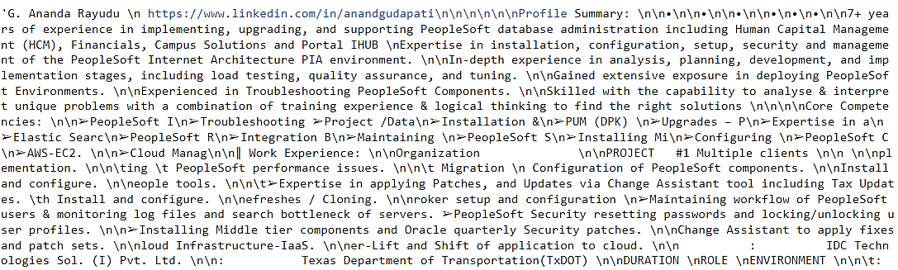
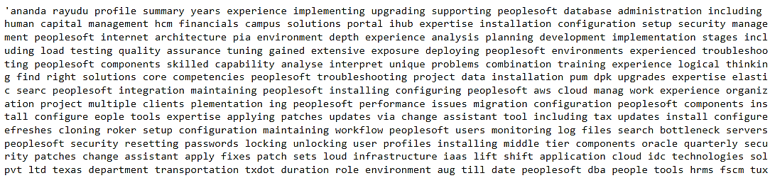
Text pre-processing :
Before Text pre-processing
After Text pre-processing

Slide 16
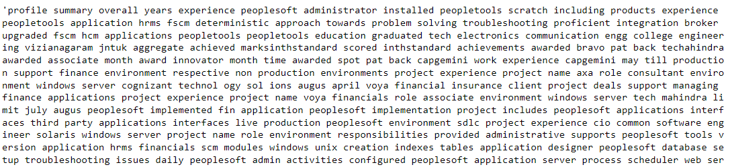
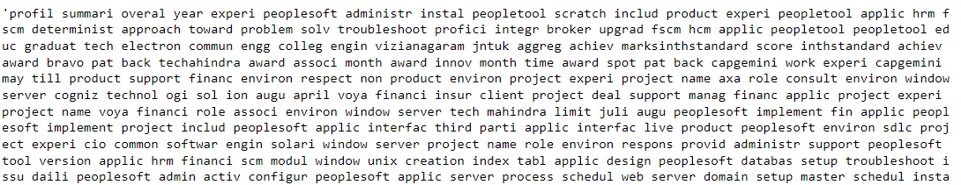
Text pre-processing :
Before Applying Porter Stemming
After Applying Porter Stemming
The Porter stemming algorithm (or 'Porter stemmer') is a process for removing the commoner morphological and inflectional endings from words in English.

Slide 17
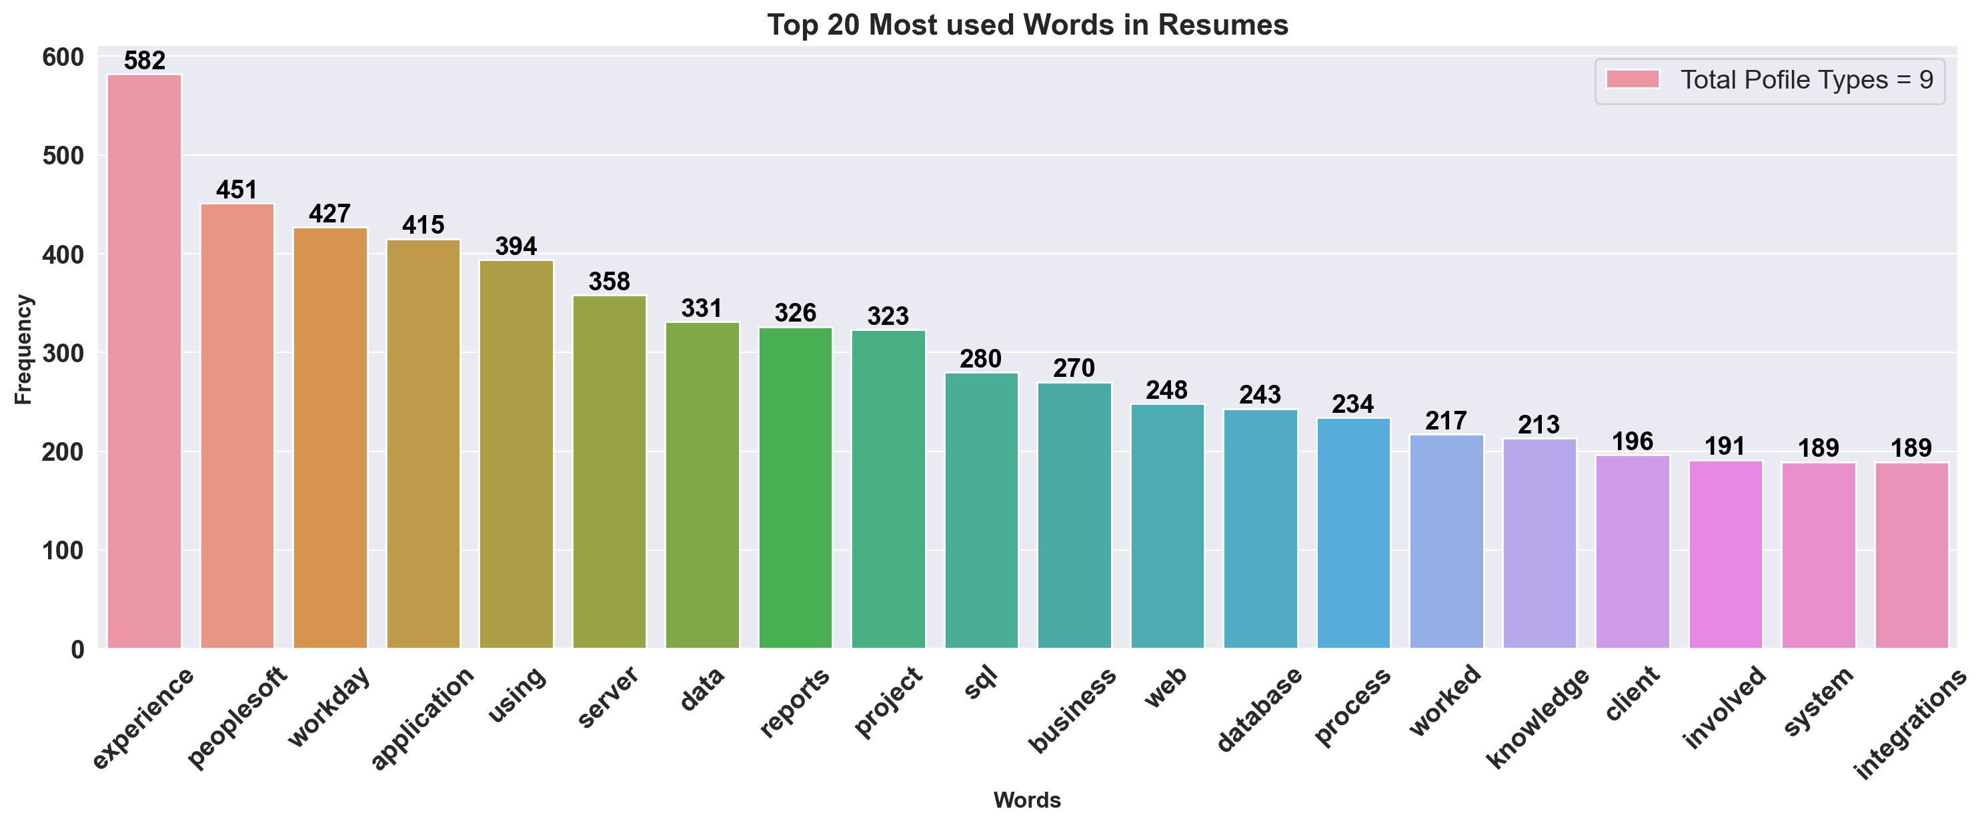
Exploratory Data Analysis :

Slide 18
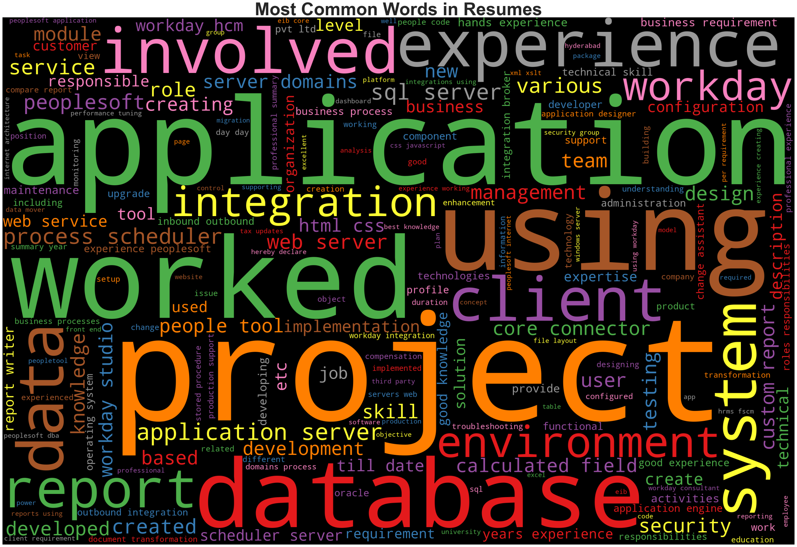
Word cloud:

Slide 19
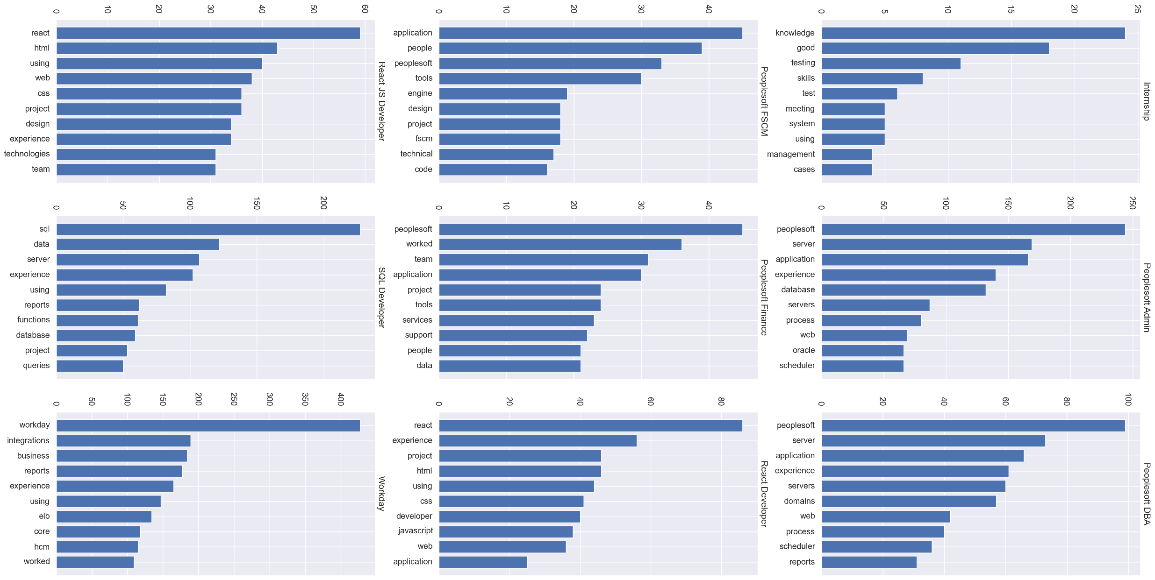
Exploratory Data Analysis :
10 most common words used in each Profile Resumes

Slide 20
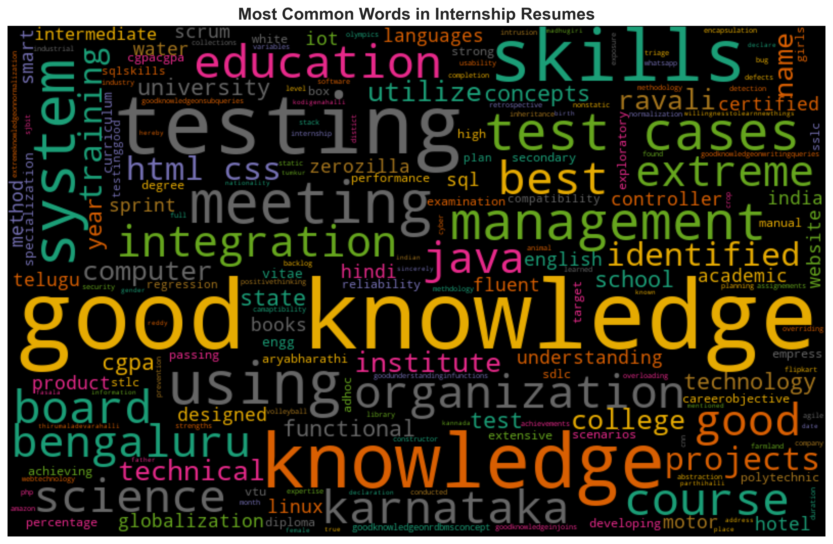
Exploratory Data Analysis :

Slide 21
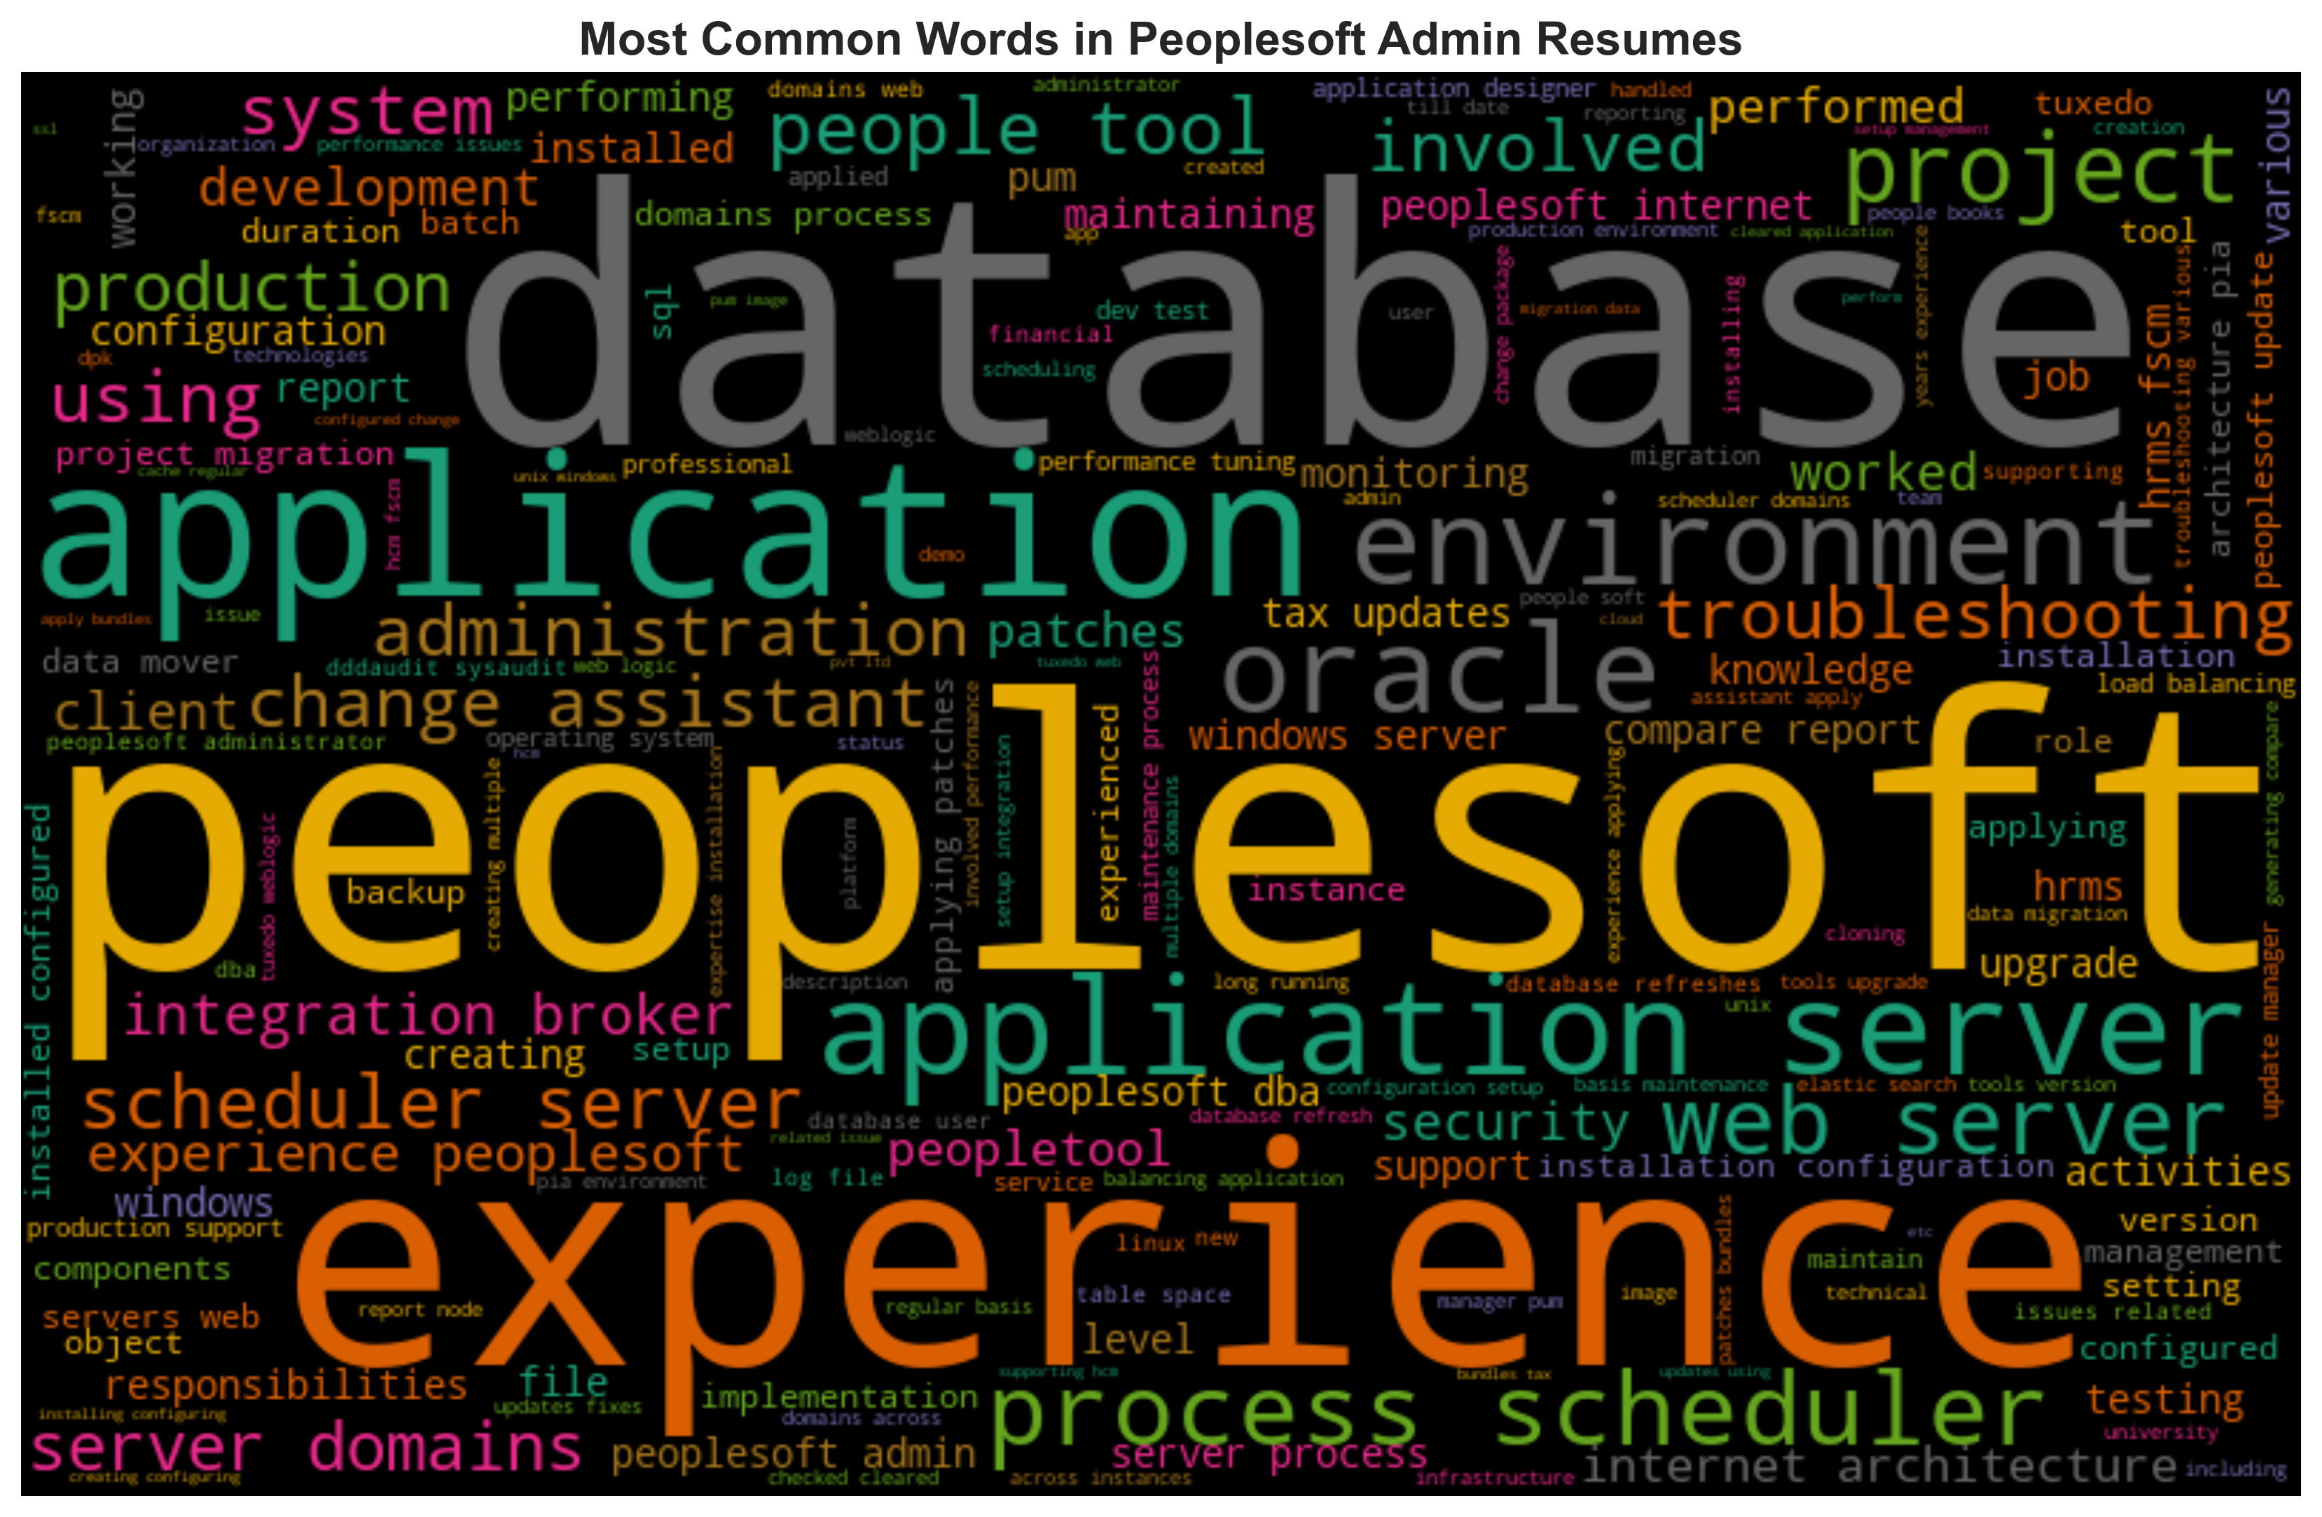
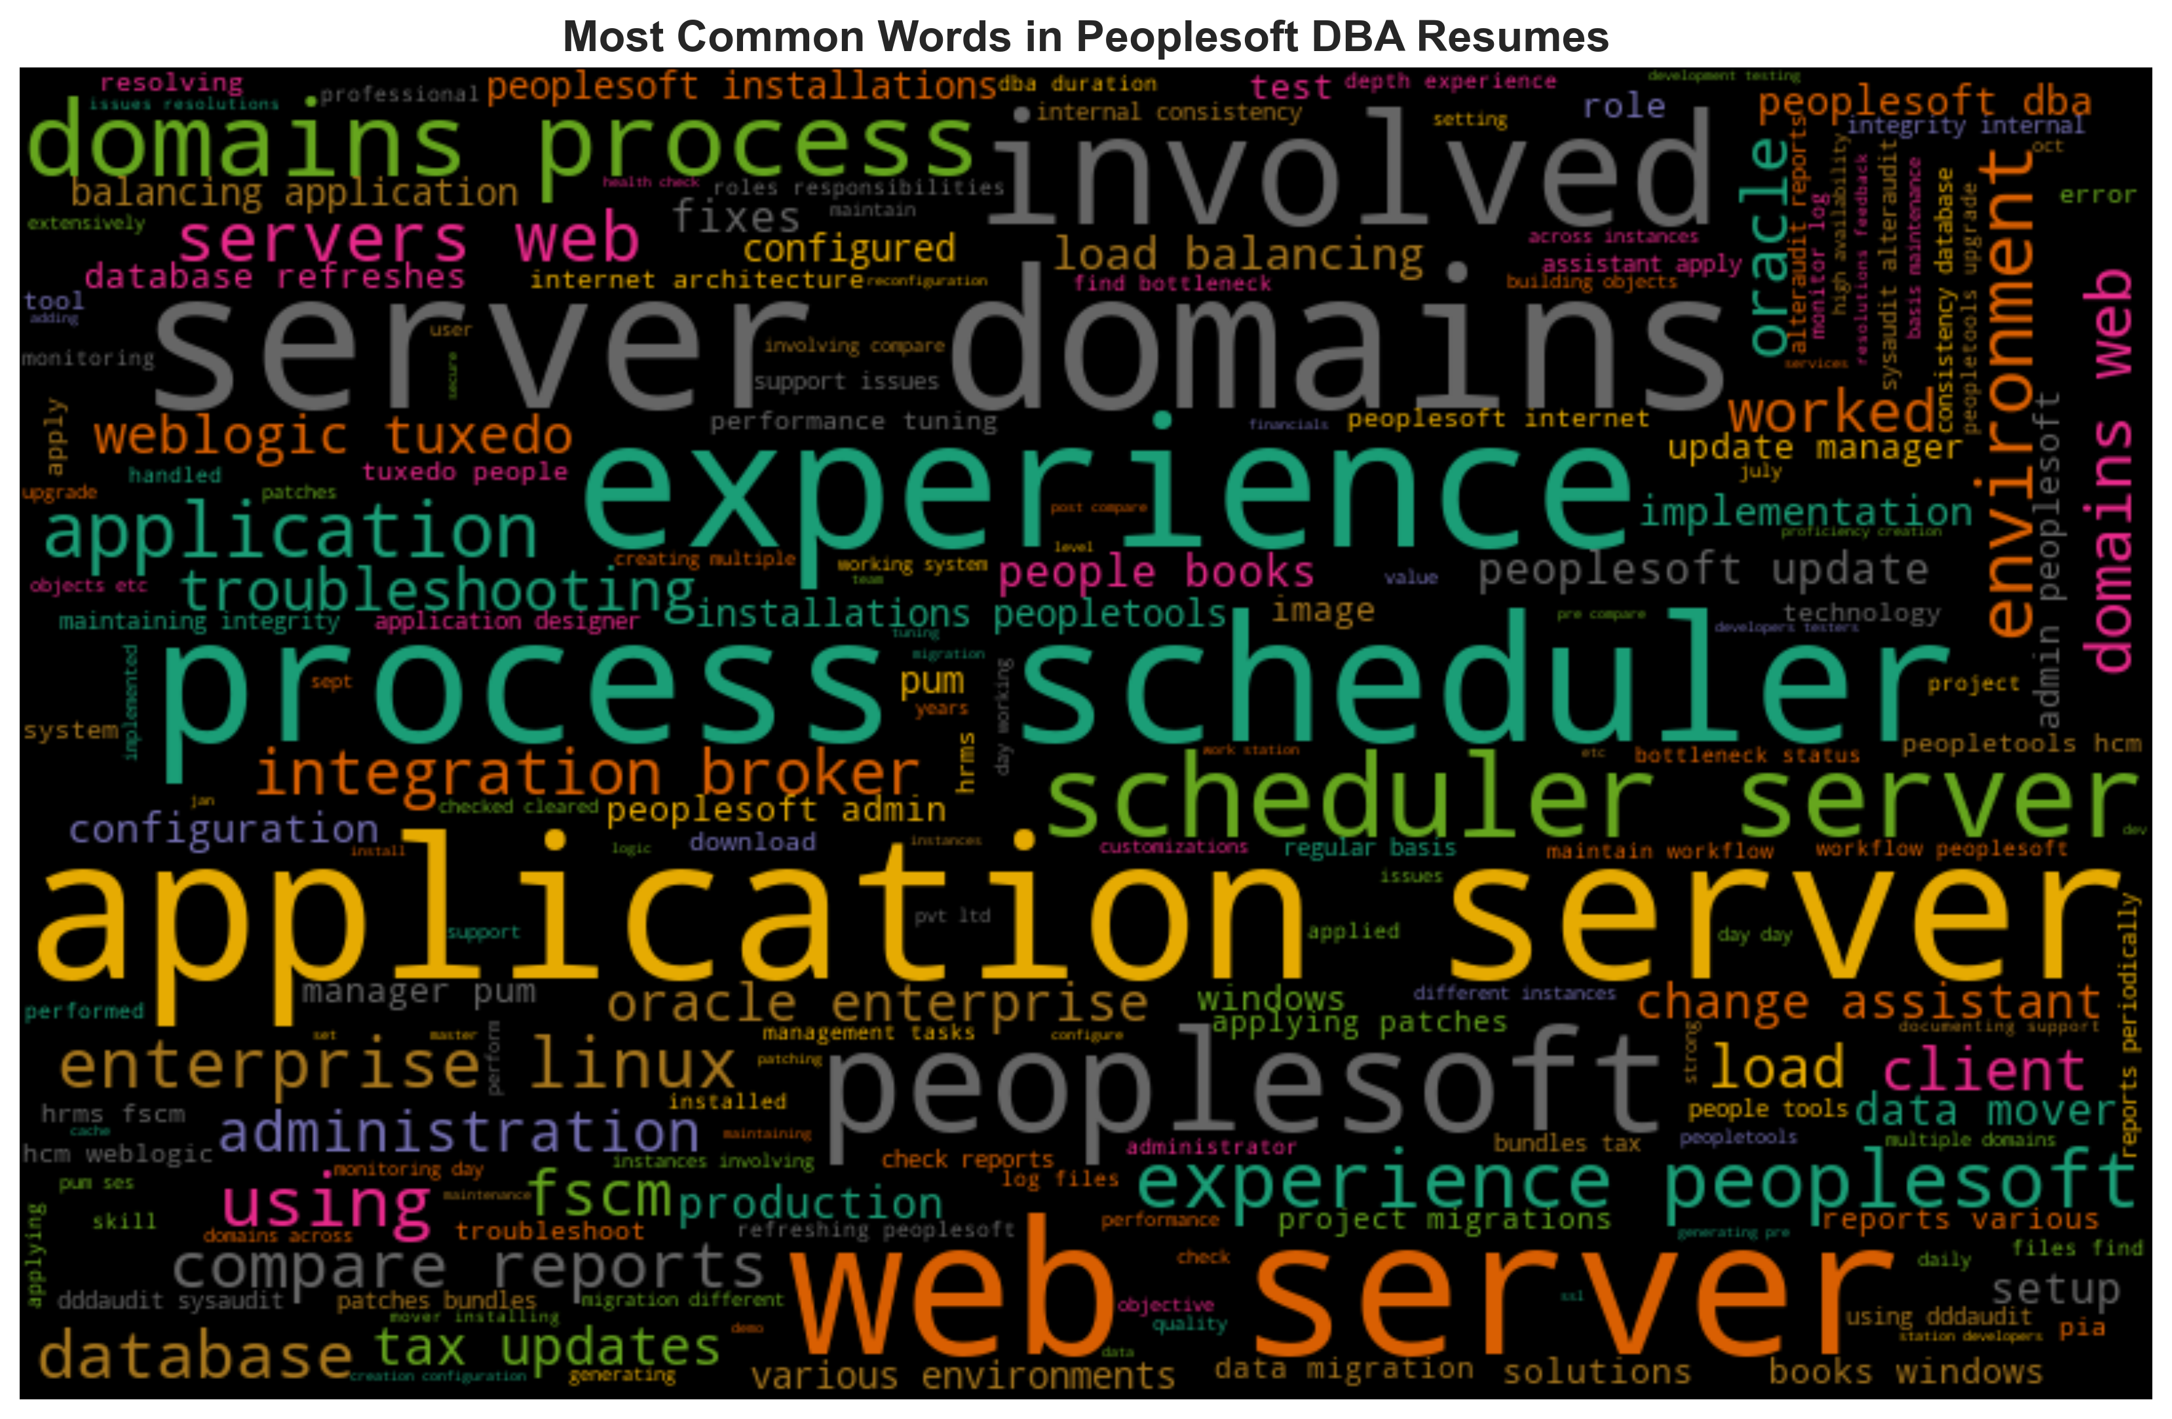
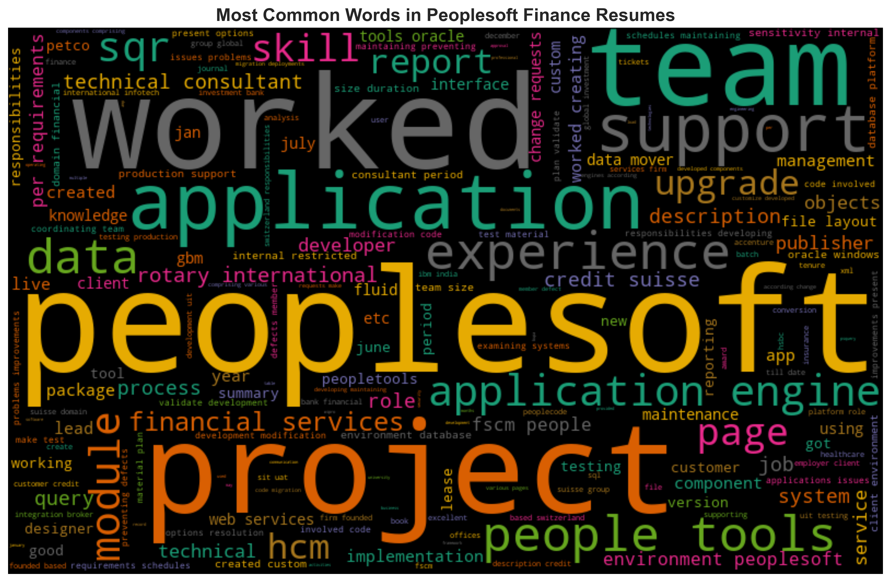
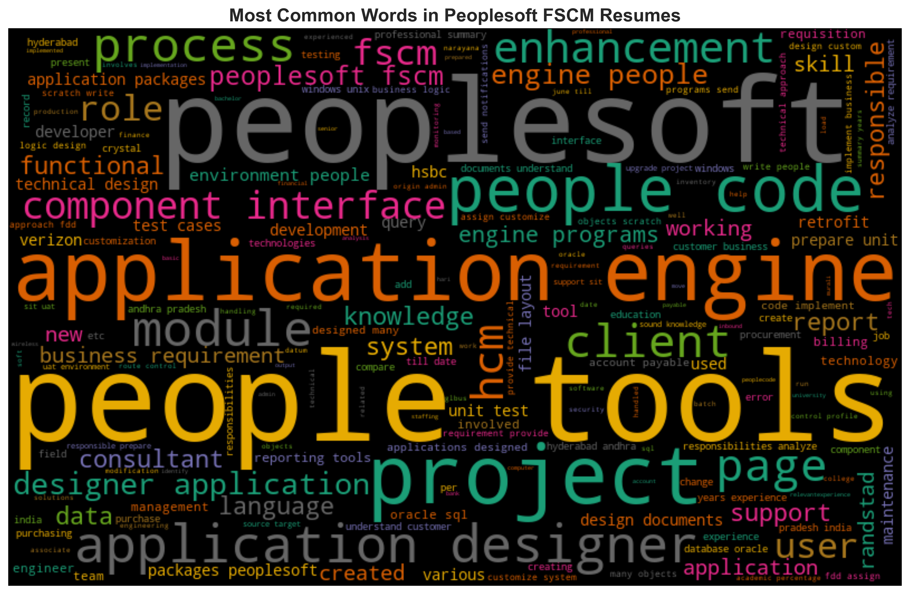
Exploratory Data Analysis :

Slide 22
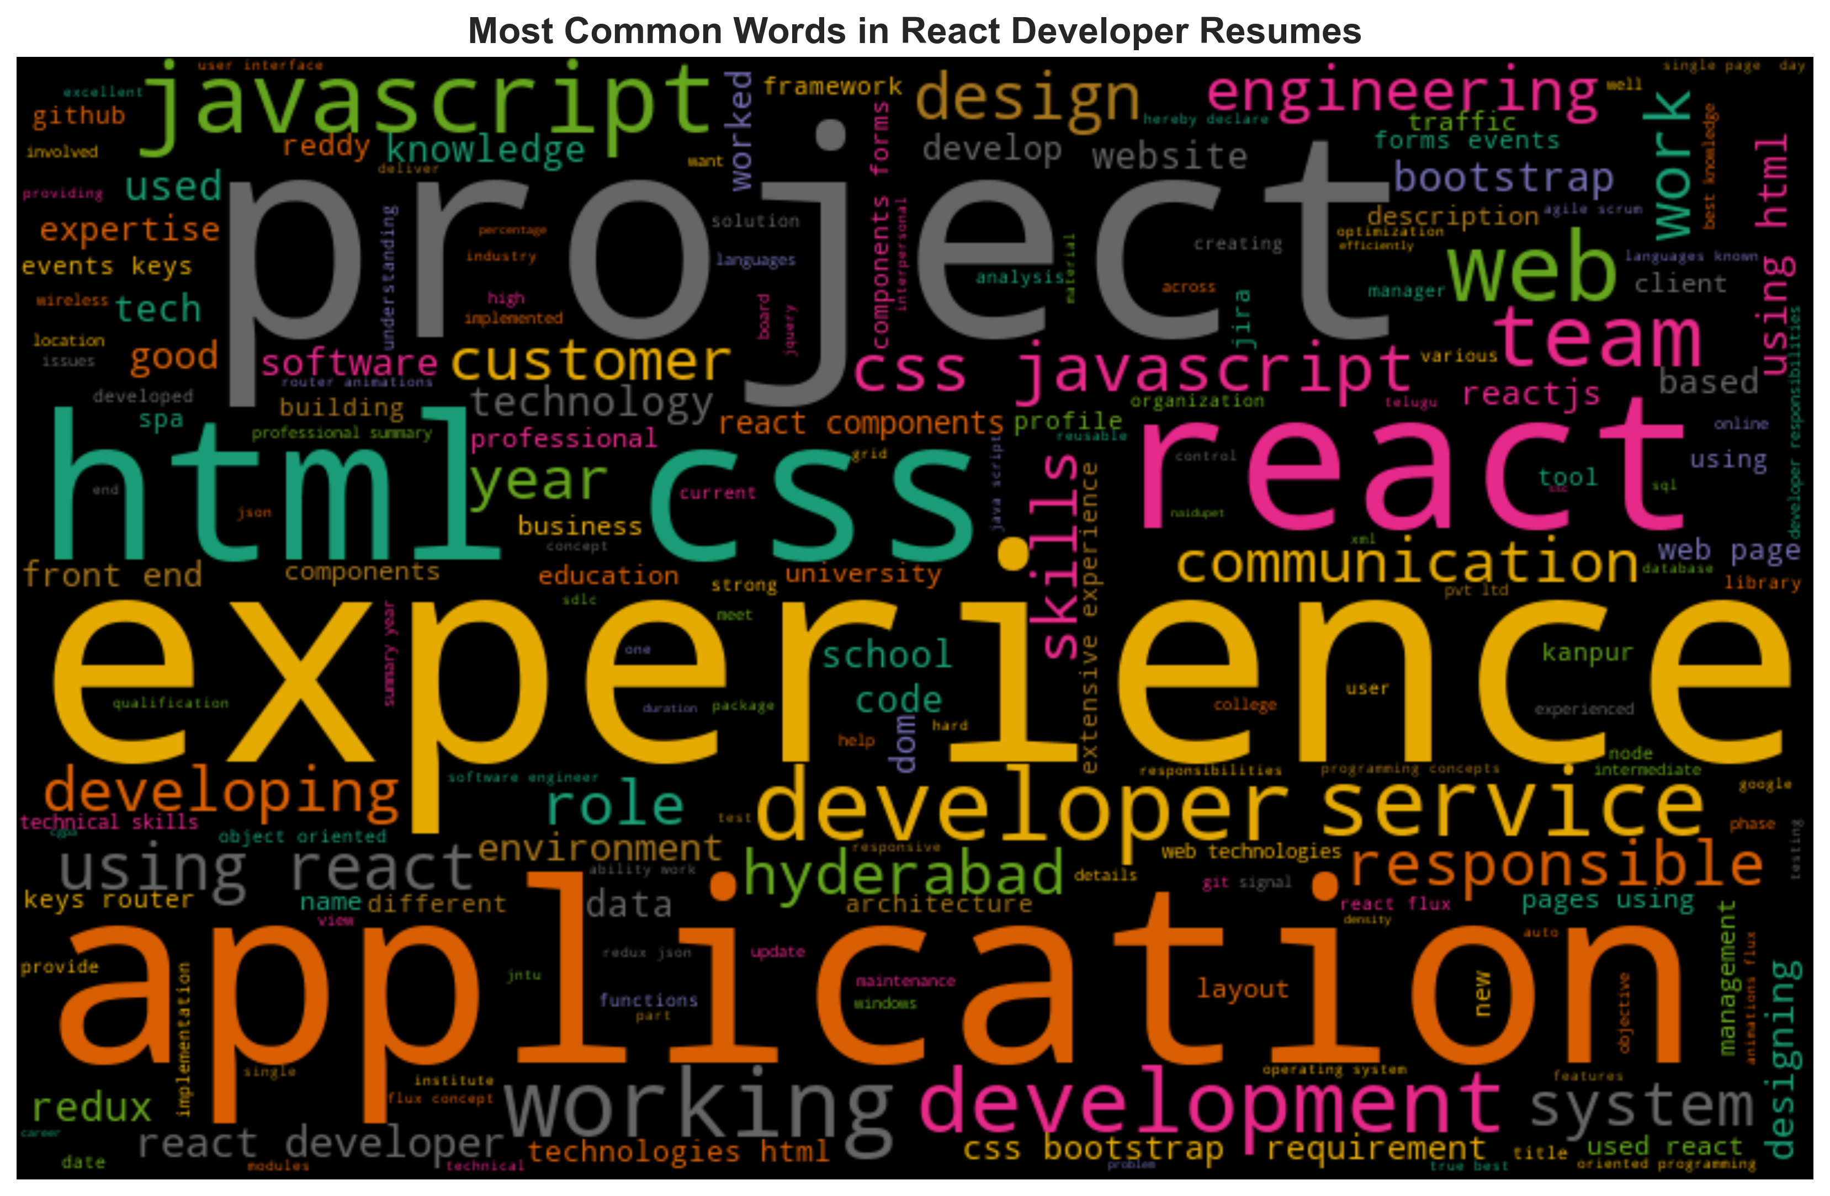
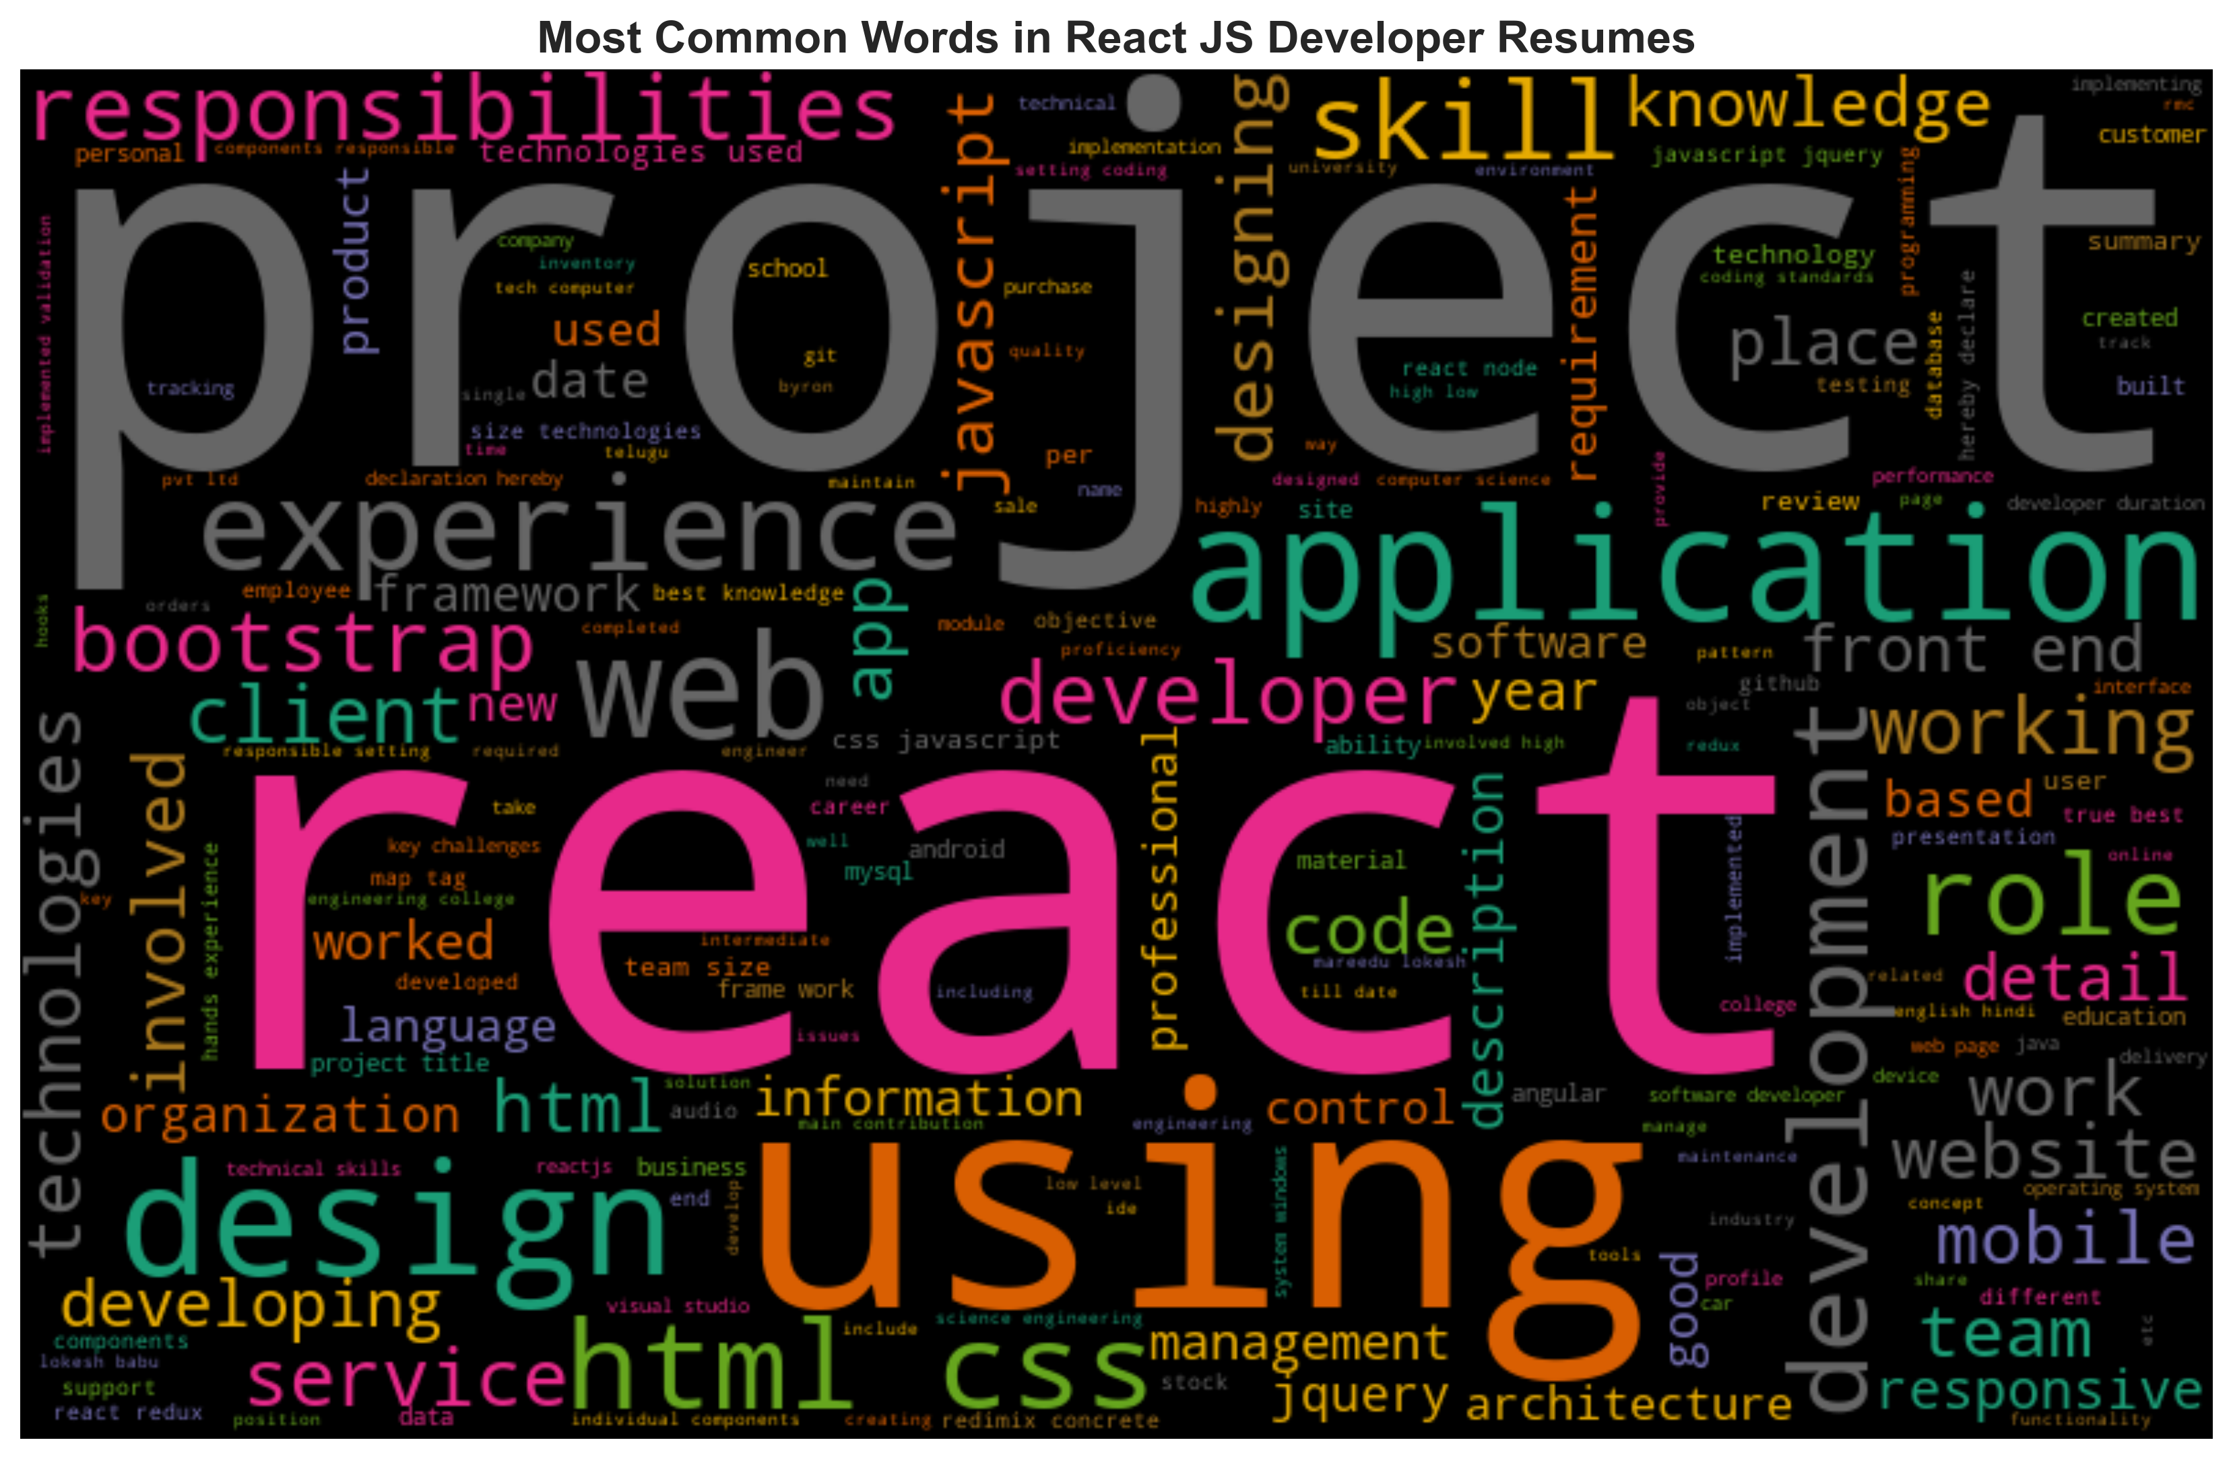
Exploratory Data Analysis :

Slide 23
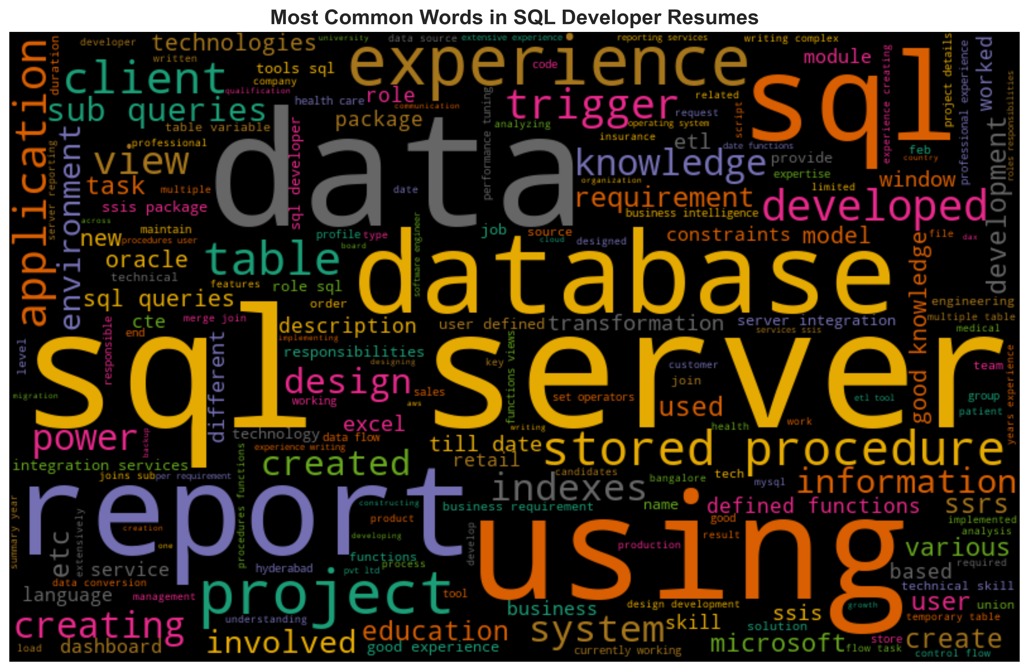
Exploratory Data Analysis :

Slide 24
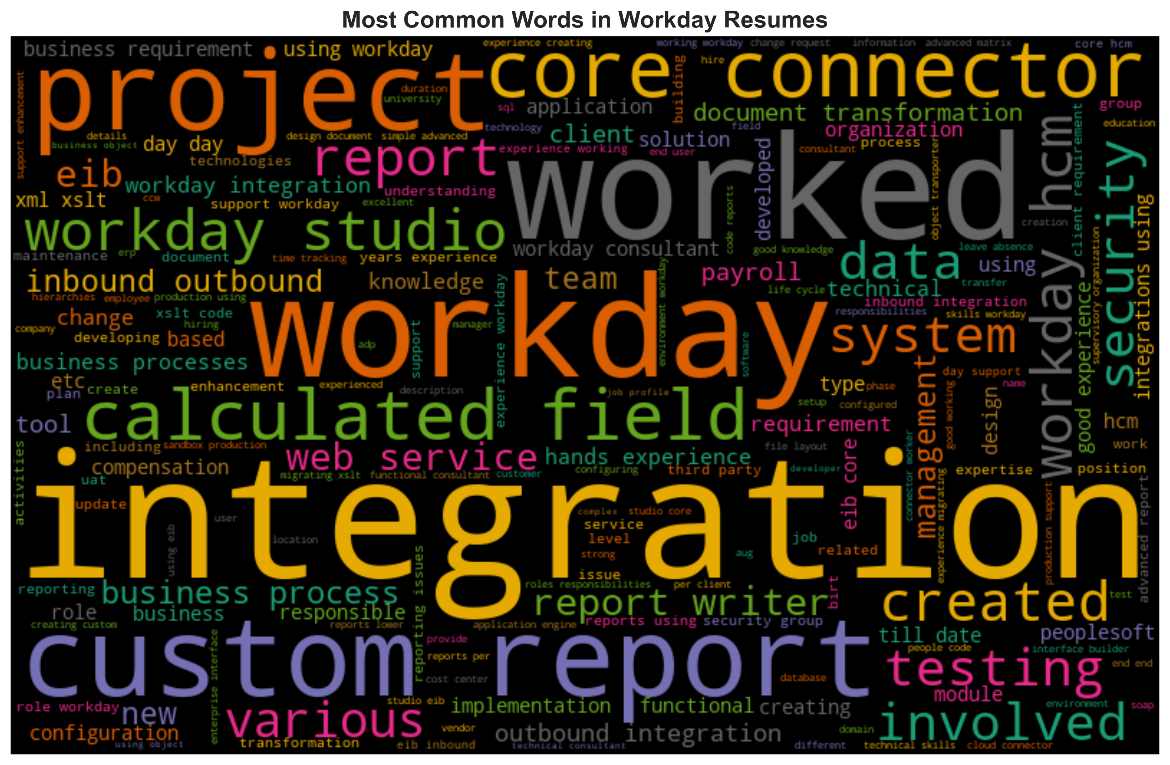
Exploratory Data Analysis :

Slide 25
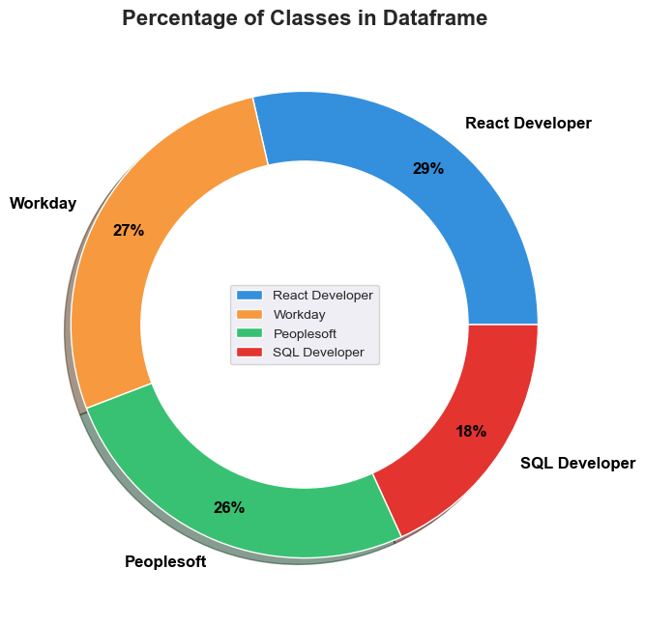
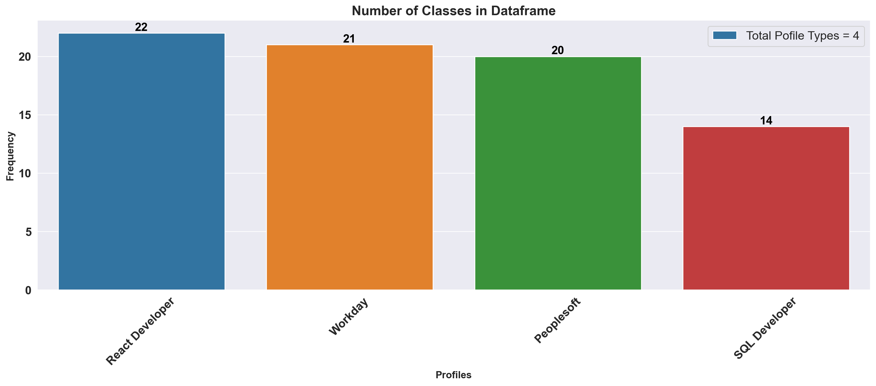
Exploratory Data Analysis :
Classes in the Data-Frame
Plotting Classes for Insights
There are Total 4 Classes in the Data Frame which means this a Multiclass Classification Problem.
Imbalance found in the dataset we can use Oversampling Techniques.

Slide 26
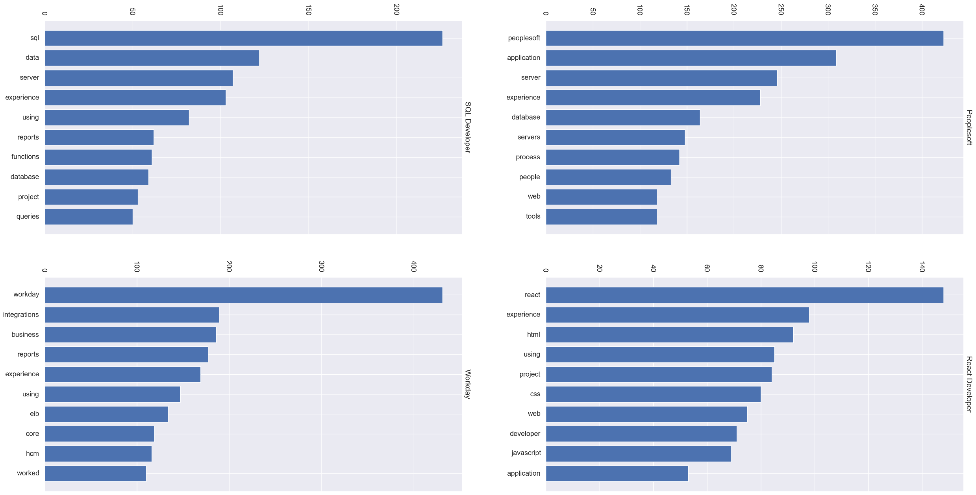
Exploratory Data Analysis :
10 Most Common Words Used in Different Classes

Slide 27
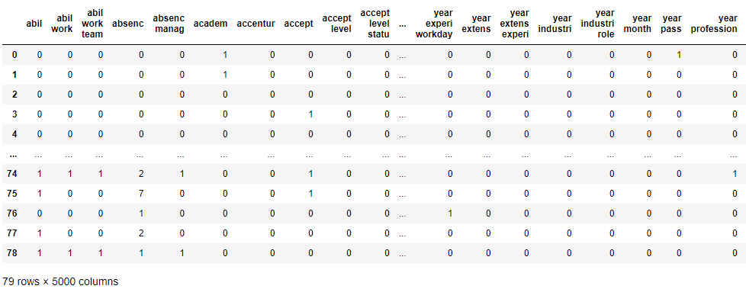
Feature Engineering :
Count Vectorizer
with N-grams (Bigrams & Trigrams)

Slide 28
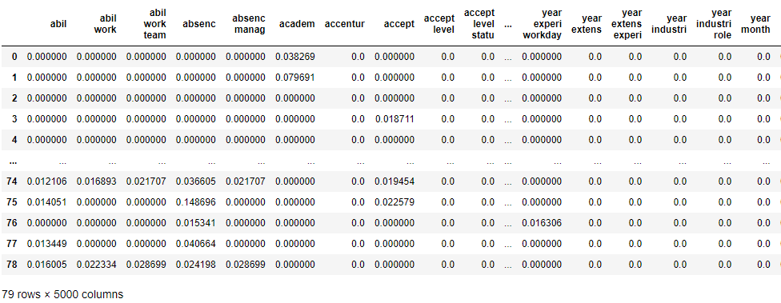
Feature Engineering :
TF-IDF Vectorizer
with N-grams (Bigrams & Trigrams)

Slide 29

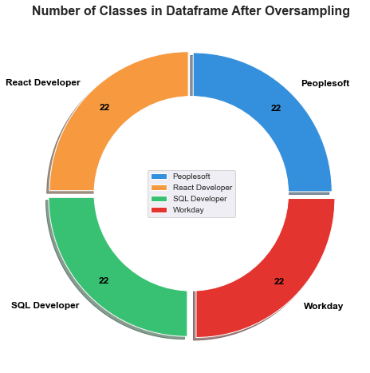
Feature Engineering :
Problems with imbalanced data classification
If explained it in a very simple manner, the main problem with imbalanced dataset prediction is how accurately are we actually predicting both majority and minority class?
SMOTE: Synthetic Minority Oversampling Technique
SMOTE is an oversampling technique where the synthetic samples are generated for the minority class. This algorithm helps to overcome the overfitting problem posed by random oversampling. It focuses on the feature space to generate new instances with the help of interpolation between the positive instances that lie together.

Slide 30
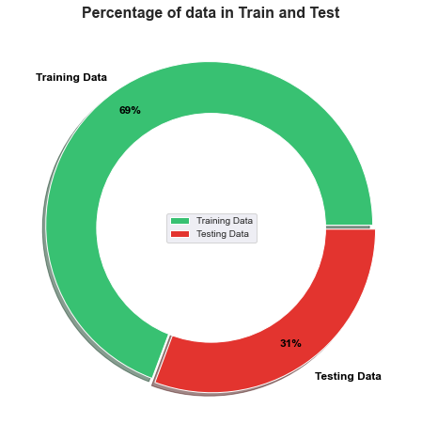
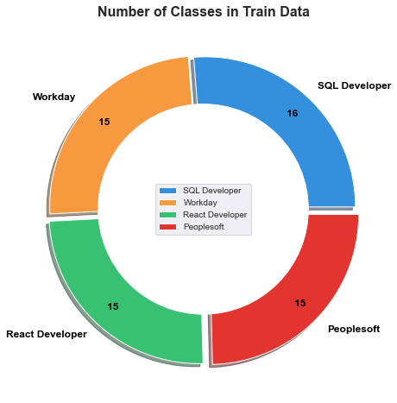
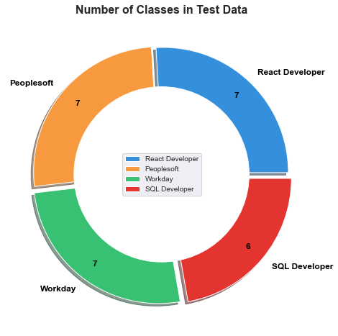
Train Test Split:
Problems with Random Data Splitting
If explained it in a very simple manner, the main problem is random splitting the data the ratio of the classes does not reflect on training and testing. Due to random splitting one class can be heavily sampled in training and creating majority and minority class issue ( Imbalanced Data) which will give rise to bad scores on test data and overall performance and misclassification.
Stratified Samling:
In stratified Sampling the ratio of all the classes is maintained on both training and testing data thus this type of Split results in good accuracy and overall model building performance.

Slide 31
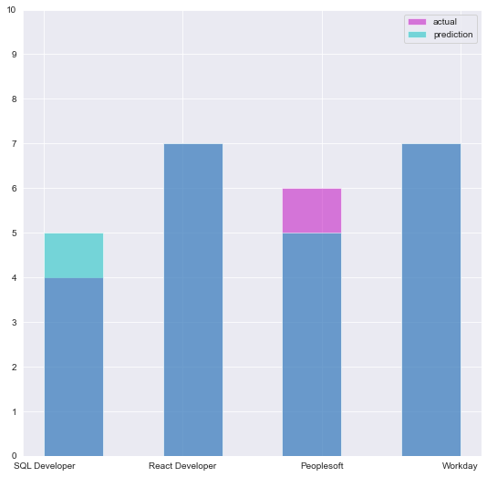
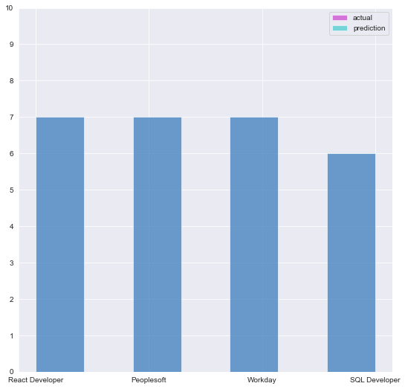
Feature Engineering:
Sometimes when the records of a certain class are much more than the other class, our classifier may get biased towards the prediction. Thus our traditional approach of classification and model accuracy calculation is not useful in the case of the imbalanced dataset
Before Oversampling After Oversampling

Slide 32
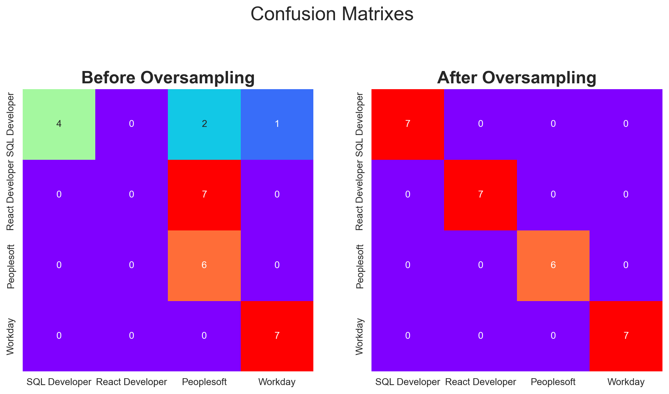
Feature Engineering:
Sometimes when the records of a certain class are much more than the other class, our classifier may get biased towards the prediction. In this case, the confusion matrix for the classification problem shows how well our model classifies the target classes and we arrive at the accuracy of the model from the confusion matrix.

Slide 33

Model Building:
If we do random sampling to split the dataset into training set and test set. Then we might get a majority of one of the class in training and minority of other in testing. If we train our model obviously we will be getting bad evaluation scores.
Stratified sampling is the solution to maintain the ratio of all classes in both training as well as in testing data

Slide 34

Model Building:
The solution for the first problem where we were able to get different accuracy scores for different random state parameter values is to use K-Fold Cross-Validation. But K-Fold Cross Validation also suffers from the second problem i.e. random sampling.
The solution for both the first and second problems is to use Stratified K-Fold Cross-Validation. Stratified k-fold cross-validation is the same as just k-fold cross-validation, But Stratified k-fold cross-validation, it does stratified sampling instead of random sampling.

Slide 35




Model Evaluation:
Accuracy on Test Data
Recall Score on Test Data
Precision on Test Data
F1-Score on Test Data

Slide 36

Model Evaluation:

Slide 37

Model Selection:
Random Forest Classification Model has 100% Accuracy on Test as well on Training Dataset.
0% Error . 100% Recall , Precision and F1-Score. No Overfitting, Underfitting or any Misclassification

Slide 38

deployment:

Slide 39

deployment:

Slide 40

deployment:

Slide 41


deployment:

Slide 42

deployment:

Slide 43


deployment:

Slide 44

deployment:

Slide 45

deployment:

Slide 46

deployment:

Slide 47


